Slide 1
Solutions, Cont.

Slide 2
Concentration
A measure of the amount of solute that is dissolved in a given quantity of solvent.
A dilute solution is one that contains a small amount of solute.
A concentrated solution contains a large amount of solute.
When a concentrated solution is diluted, the amount of solute doesn’t change.

Slide 3
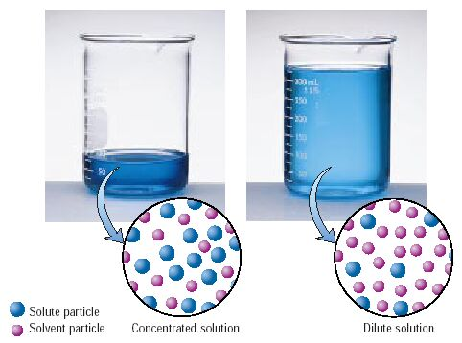

Slide 4
Concentrated and dilute are qualitative descriptions. There is a quantitative description.
Molarity, M = moles of solute mol
liters of solution L
Abbreviated with a capital M, such as 6.0 M
The most widely used concentration unit in chemistry.
Brackets around a compound indicate molarity. [HCl]

Slide 5
Using Molarity
Rearrange the molarity equation to solve for each of the variables.
M =
mol =
L =

Slide 6
Using Molarity
Sometimes the mass unit given in the problem is grams.
Before we can use the molarity equation, we’ll need to change it to moles.
Change 6.8 g NaCl to moles.

Slide 7
Using Molarity
Sometimes the volume unit given in the problem is mL.
Before we can use the molarity equation, we’ll need to change it to Liters.
1 mL = 10⁻³ L
Change 135 mL into L

Slide 8
Practice
What is the molarity of a solution in which 10.0 g of AgNO₃ is dissolved in 500. mL of solution?

Slide 9
Using Molarity
How many grams of CuSO₄ • 5 H₂O are needed to prepare 100. mL of a 0.10 M solution? (2.5 g)

Slide 10
Using Molarity
To what volume should 5.0 g of KCl be diluted in order to prepare a 0.25 M solution? (0.27 L)

Slide 11
Other units of concentration
Percent by mass (mass percent) = g solute/100 g solution
Percent by volume = mL solute/100 mL of solution
Parts per million (ppm) = 1 milligram of something per liter of water (mg/l) or 1 milligram of something per kilogram soil (mg/kg)
Parts per billion (ppb) = 1 microgram of something per liter of water (mg/l) or 1 microgram of something per kilogram soil (mg/kg)

Slide 12
Dilution
Often a needed concentration of solution is made by diluting a more concentrated or “stock” solution.
We use the equation M₁V₁ = M₂V₂

Slide 13
Dilution
M₁ and V₁ are the concentrated, stock molarity and volume.
M₂ and V₂ are the diluted molarity and volume.
The volume units have to match each other but can be in mL or L.

Slide 14
Using Dilution
It is helpful to make a chart of the known and unknown variables.
How many milliliters of aqueous 2.00M MgSO₄ solution must be diluted with water to prepare 100.0 mL of aqueous 0.400 M MgSO₄? (20.0 mL)
Stock, concentrated: Final, diluted:
M₁= _______ M₂= _______
V₁= _______ V₂= _______

