Slide 1
Liquids, Solids, and Thermochemistry

Slide 2
Essential questions
How do the arrangements of particles in liquids and solids differ?
What are the factors that affect viscosity?
Vocabulary
viscosity
surface tension
surfactant
crystalline solid
unit cell
allotrope
amorphous solid
Liquids and Solids
Copyright © McGraw-Hill Education

Slide 3
Liquids
Molecules closely packed in a fixed volume, but not in a fixed position.
Much denser than gases (stronger intermolecular forces)
Virtually incompressible
Fluid (Fluidity = ability to flow and diffuse)
Liquids and Solids
Copyright © McGraw-Hill Education

Slide 4
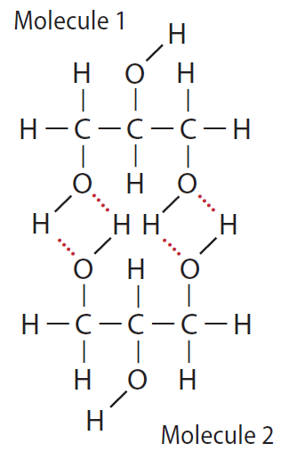
Liquids
The hydrogen atoms attached to the oxygen atoms in each molecule are able to form hydrogen bonds with other glycerol molecules.
Viscosity = measure of the resistance of a liquid to flow
Determined by the
Type of IMF
Particle shape and size
Temperature.
Liquids and Solids
Copyright © McGraw-Hill Education

Slide 5
Liquids
Stronger IMFs = higher viscosity.
Larger molecules or long chains of molecules have higher viscosity
Higher temperature = lower viscosity
More energy allows the molecules to overcome intermolecular forces and flow more freely.
Liquids and Solids
Copyright © McGraw-Hill Education

Slide 6
Liquids
Surface tension = energy required to increase the surface area of a liquid by a given amount.
Measure of the inwards pull of particles on the surface by particles in the interior.
Stronger intermolecular forces = stronger surface tension
Surfactants = compounds that lower the surface tension of water (ex. soap)
Liquids and Solids
Copyright © McGraw-Hill Education

Slide 7
Liquids
Cohesion vs. adhesion
Cohesion = force of attraction between identical molecules.
Adhesion = force of attraction between different molecules.
Capillary action = upward movement of liquid into a narrow cylinder, or capillary tube.
Due to adhesion of molecules to the surface of the tube
Liquids and solids
Copyright © mcgraw-hill education

Slide 8
Solids
Very strong attractive intermolecular forces between particles.
Particles vibrate in a fixed position.
More dense than liquids.
Exception: ice is less dense than water. Why?
Amorphous solids - particles are not arranged in a regular, repeating pattern.
Form when molten material cools quickly.
Ex.: Gas, rubber, and many plastics
Liquids and Solids
Copyright © McGraw-Hill Education

Slide 9
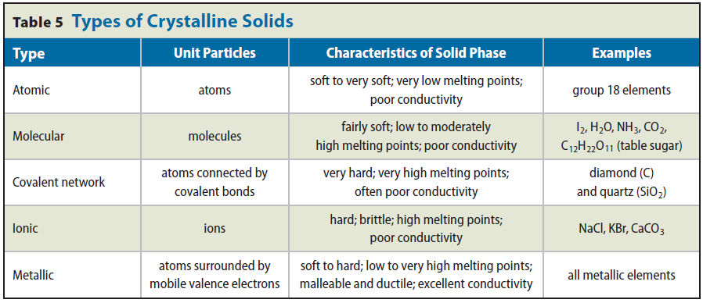

Slide 10
Essential questions
What is energy?
How do potential and kinetic energy differ?
How can chemical potential energy be related to the heat lost or gained in chemical reactions?
How is the amount of heat absorbed or released by a substance calculated as its temperature changes?
Vocabulary
energy
law of conservation of energy
chemical potential energy
heat
calorie
joule
specific heat
Copyright © McGraw-Hill Education

Slide 11
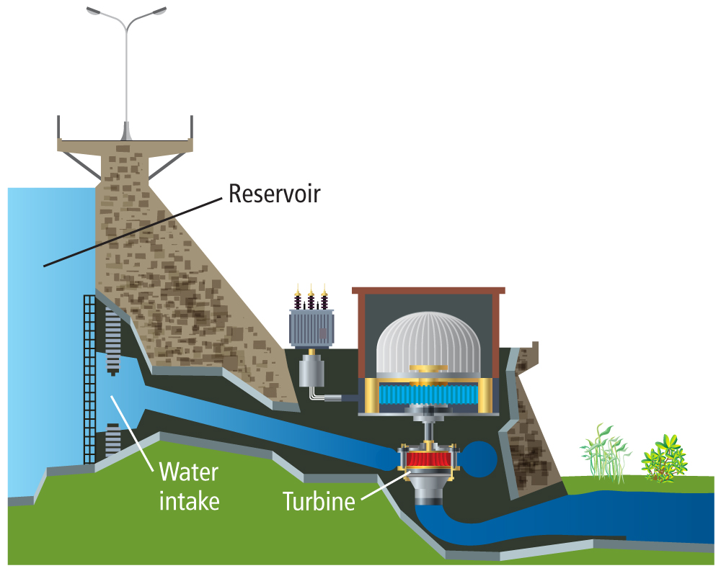
Energy
Ability to do work or produce heat
Potential energy = energy of position or composition (what something is made of)
Chemical potential energy: energy stored in a substance because of its composition.
Kinetic energy = energy of motion.
Law of Conservation of Energy: energy is never created or destroyed, it is only transferred
Energy
Copyright © McGraw-Hill Education

Slide 12
Heat, q
Flows from a warmer object to a cooler object.
Units for measuring heat
calorie (cal), amount of energy required to raise the temperature of 1 g of water 1°C.
The energy content of food is measured in Calories, or 1000 calories (kilocalorie).
Joule (J), SI unit of heat & energy (4.184 J=1 cal)
Energy
Copyright © McGraw-Hill Education

Slide 13
A breakfast of cereal, orange juice, and milk might contain 230 nutritional Calories. Express this energy in joules.
230 Calories × $\frac{\text{1000 }\text{cal}}{\text{1 }\text{Calorie}}$= 230000 cal
230000 cal × $\frac{\text{4.184 }\text{J}}{\text{1 }\text{cal}}$= 960000 J
KNOWN
amount of energy = 230 Calories
UNKNOWN
amount of energy = ? J
Energy
Copyright © McGraw-Hill Education

Slide 14
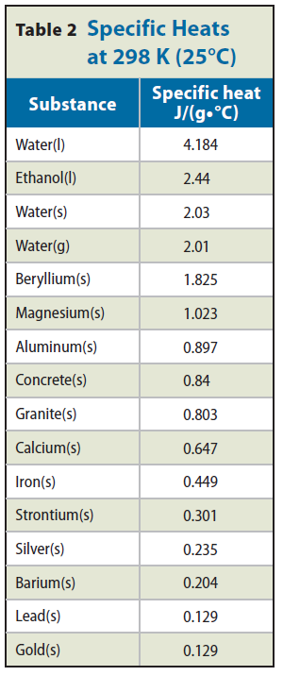
Specific Heat, c
Amount of heat required to raise 1 g of a specific substance 1°C.
Some objects require more heat than others to raise their temperatures.
q = m x c x ΔT
q = heat absorbed/lost
m = mass
c = specific heat of substance
ΔT = T_{final} – T_{initial}
Energy
Copyright © McGraw-Hill Education

Slide 15
ΔT = 50.4°C – 25.0°C = 25.4°C
q = m × c × ΔT
$\frac{\text{m}\text{ × }\text{c}\text{ × }\text{Δ}\text{T} }{\text{m} \text{×} \text{Δ}\text{T}}$= $\frac{\text{q}}{\text{m} \text{×} \text{Δ}\text{T} }$
c = $\frac{\text{114 }\text{J}}{\text{(10.0 }\text{g}\text{)(25.4}\text{°}\text{C}\text{) }}$
c = 0.449 J/(g•°C)
The temperature of a sample of iron with a mass of 10.0 g changed from 50.4°C to 25.0°C with the release of 114 J. What is the specific heat of iron?
KNOWN
energy released = 114 J T_{i} = 50.4°C
mass of iron = 10.0 g Fe T_{f} = 25.0°C
UNKNOWN
specific heat of iron, c = ? J/(g•°C)
Energy
Copyright © McGraw-Hill Education

Slide 16
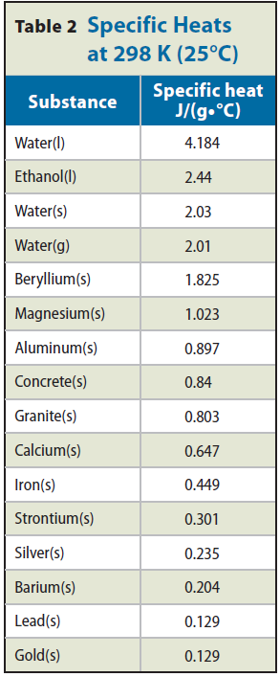
A piece of metal with a mass of 4.68 g absorbs 256 J of heat when its temperature increases by 182°C. What is the specific heat of the metal? Could the metal be one of the alkaline earth metals listed in Table 2?
q = m × c × ΔT
c = $\frac{\text{q}}{\text{m} \text{×} \text{Δ}\text{T} }$
c = $\frac{\text{256 }\text{J}}{\text{(4.68 }\text{g}\text{)(182}\text{°}\text{C}\text{)}}$
c = 0.301 J/(g•°C)
Table 2 indicates that the metal could be strontium.
KNOWN
mass of metal, m = 4.68 g
quantity of heat absorbed, q = 256 J
ΔT = 182°C
UNKNOWN
specific heat, c = ? J/(g•°C)
Heat
Copyright © McGraw-Hill Education

Slide 17
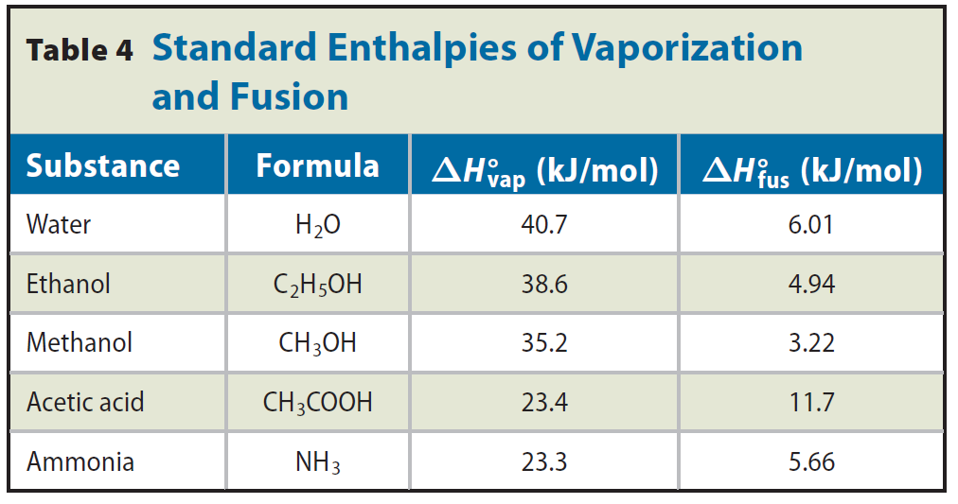
Changes of state
Molar enthalpy (heat) of vaporization = heat required to vaporize 1 mol of a liquid substance.
Molar enthalpy (heat) of fusion = heat required to melt 1 mol of a solid substance.
Thermochemical Equations
Copyright © McGraw-Hill Education

Slide 18
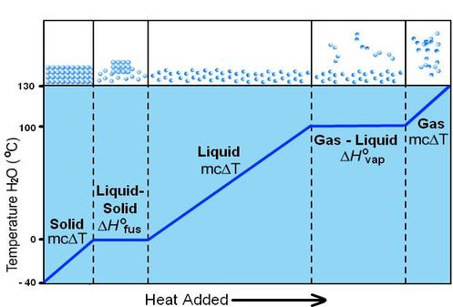
Heating curve
Thermochemical Equations
Copyright © McGraw-Hill Education

Slide 19
Draw and label a heating curve for a 0.5 mol sample of acetic acid that is heated from 0°C to 130°C. Use Table 4 as a reference.
Specific heat: 2.043 J/(g•°C)
Melting point: 16.6 °C
Boiling point: 118.1°C
Heat
Copyright © McGraw-Hill Education

Slide 20
Essential questions
How can the addition and removal of energy cause a phase change?
What is a phase diagram?
Vocabulary
melting point
vaporization
evaporation
vapor pressure
boiling point
freezing point
condensation
deposition
phase diagram
triple point
Phase Changes
Copyright © McGraw-Hill Education

Slide 21
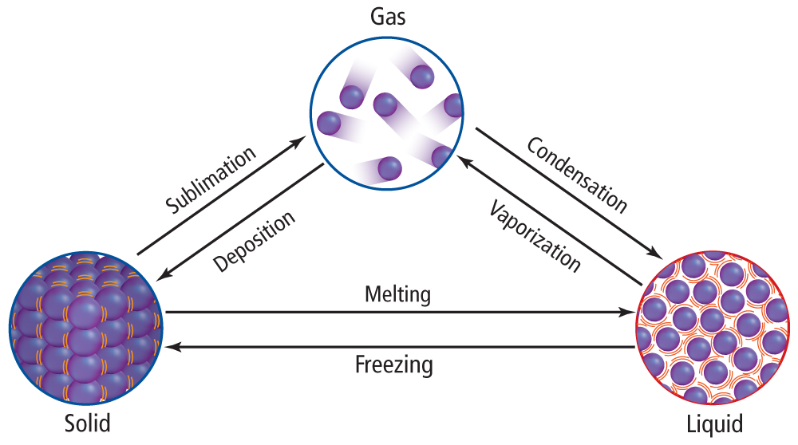
Heat = the transfer of energy from an object at a higher temperature to an object at a lower temperature.

Slide 22
Vocabulary
You have been given an envelope with a bunch of vocabulary words.
Your task is to figure out how all of these words are related…some will be easy, some will be more difficult.
You may use ONLY the glossary in the back of the book to look up definitions…no peeking anywhere else in the book!
Once you think you have the right arrangement, see the teacher.
Once I have approved your arrangement, write 1-2 paragraphs that include ALL of the vocabulary words and how they are related. This is your exit slip.

Slide 23
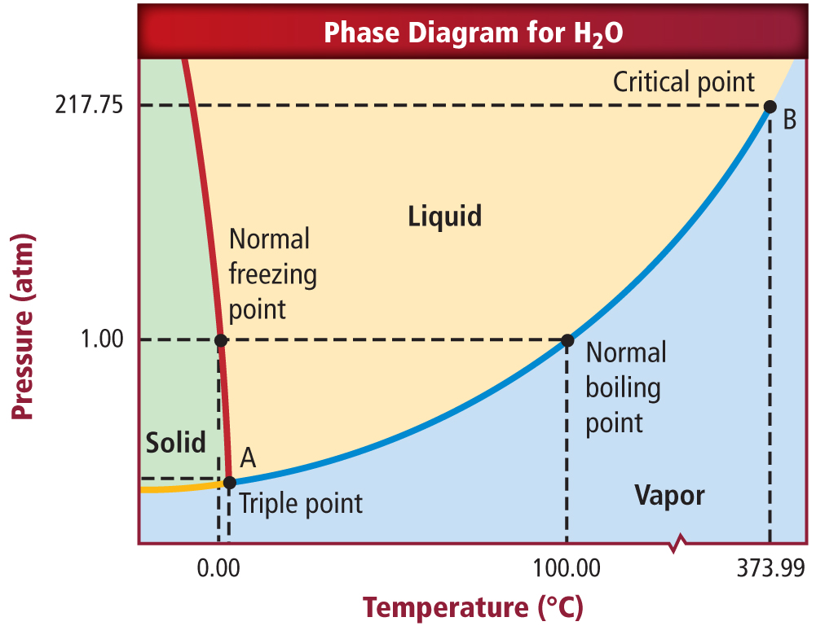
Phase Diagrams
Phase Changes
Copyright © McGraw-Hill Education

Slide 24
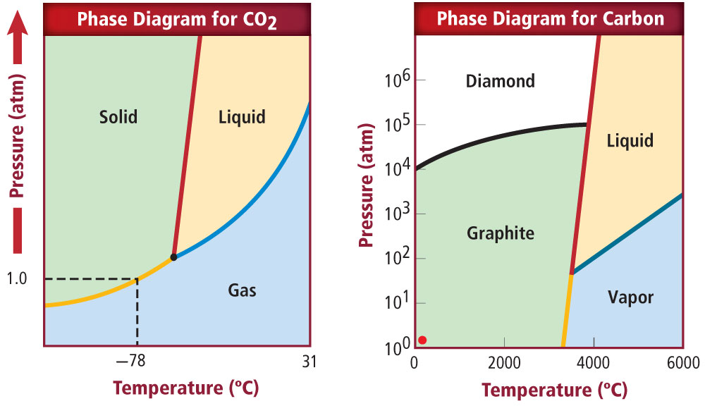
Phase Changes
Copyright © McGraw-Hill Education

