Slide 1
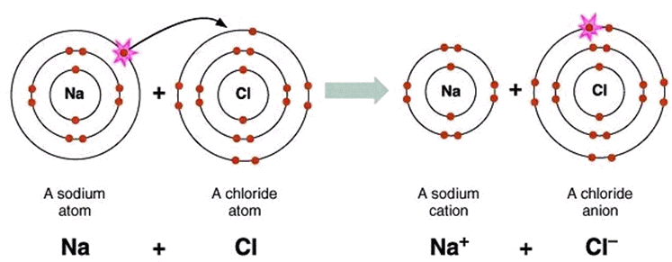
Ionic Bonding

Slide 2
Bonds
Forces that hold groups of atoms
together and make them function
as a unit.
Ionic bonds – transfer of electrons
Covalent bonds – sharing of electrons

Slide 3
The Octet Rule – Ionic Compounds
Ionic compounds form so that each atom, by gaining or losing electrons, has an octet of electrons in its highest occupied energy level.
Metals lose electrons to form positively-charged cations
Nonmetals gains electrons to form negatively-charged anions

Slide 4
Ionic Bonding: The Formation of Sodium Chloride
Sodium has 1 valence electron
Chlorine has 7 valence electrons
An electron transferred gives
each an octet
Na: 1s²2s²2p⁶3s¹
Cl: 1s²2s²2p⁶3s²3p⁵

Slide 5
Ionic Bonding: The Formation of Sodium Chloride
This transfer forms ions, each with an octet:
Na⁺ 1s²2s²2p⁶
Cl⁻ 1s²2s²2p⁶3s²3p⁶

Slide 6
Ionic Bonding: The Formation of Sodium Chloride
The resulting ions come together due to electrostatic attraction
(opposites attract):
Na⁺
Cl⁻
The net charge on the compound must equal zero

Slide 7
Examples of Ionic compounds
Mg²⁺Cl⁻₂
Magnesium chloride: Magnesium loses two electrons and each chlorine gains one electron
Na⁺₂O²⁻
Sodium oxide: Each sodium loses one electron and the oxygen gains two electrons
Al³⁺₂S²⁻₃
Aluminum sulfide: Each aluminum loses two electrons (six total) and each sulfur gains two electrons (six total)

Slide 8
Metal | Monatomic Cations | Ion name
Lithium | Li⁺ | Lithium
Sodium | Na⁺ | Sodium
Potassium | K⁺ | Potassium
Magnesium | Mg²⁺ | Magnesium
Calcium | Ca²⁺ | Calcium
Barium | Ba²⁺ | Barium
Aluminum | Al³⁺ | Aluminum

Slide 9
Nonmetal | Monatomic Anions | Ion Name
Fluorine | F⁻ | Fluoride
Chlorine | Cl⁻ | Chloride
Bromine | Br⁻ | Bromide
Iodine | I⁻ | Iodide
Oxygen | O²⁻ | Oxide
Sulfur | S²⁻ | Sulfide
Nitrogen | N³⁻ | Nitride
Phosphorus | P³⁻ | Phosphide

Slide 10
Properties of Ionic Compounds
Structure: | Crystalline solids
Melting point: | Generally high
Boiling Point: | Generally high
Electrical Conductivity: | Excellent conductors, molten and aqueous
Solubility in water: | Generally soluble

