Slide 1
What do you know about gases?

Slide 2
Essential Questions
How is the kinetic-molecular theory used to explain the behavior of gases?
Why does mass affect the rates of diffusion and effusion?
How is gas pressure measured and how is the partial pressure of a gas calculated?
Gases
Copyright © McGraw-Hill Education

Slide 3
Kinetic-Molecular Theory
Explains the different properties of solids, liquids, and gases.
Atomic composition affects chemical properties.
Atomic composition also affects physical properties.
Describes the behavior of matter in terms of particles in motion.
Gases
Copyright © McGraw-Hill Education

Slide 4
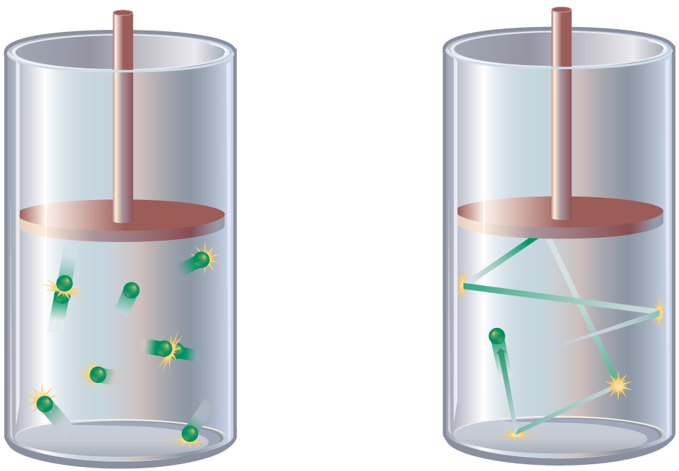
Kinetic-Molecular Theory
Gases consist of small particles separated by empty space.
Gas particles are too far apart to experience significant attractive or repulsive forces.
Gas particles are in constant random motion.
Collisions between gas particles are elastic.
An elastic collision is one in which no kinetic energy is lost.
Gases
Copyright © McGraw-Hill Education

Slide 5
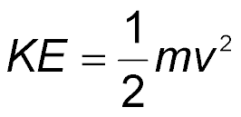
Kinetic-Molecular Theory
Kinetic energy of a particle depends on mass and velocity.
Temperature is a measure of the average kinetic energy of the particles in a sample of matter.
Gases
Copyright © McGraw-Hill Education

Slide 6
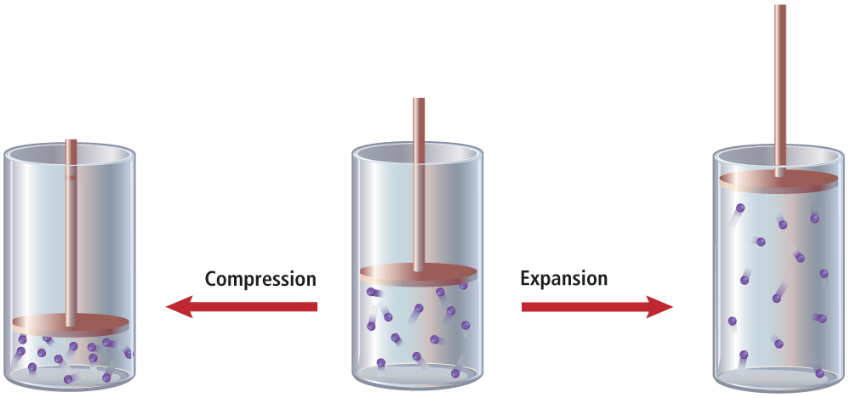
Explaining the Behavior of Gases
Great amounts of space exist between gas particles.
Compression reduces the empty spaces between particles.
Gases
Copyright © McGraw-Hill Education

Slide 7
Explaining the Behavior of Gases
Gases easily flow past each other because there are no significant forces of attraction.
Diffusion is the movement of one material through another.
Effusion is a gas escaping through a tiny opening.
Gases
Copyright © McGraw-Hill Education

Slide 8
Explaining the Behavior of Gases
Graham’s law of effusion states that the rate of effusion for a gas is inversely proportional to the square root of its molar mass.
Graham’s law also applies to diffusion.
Gases
Copyright © McGraw-Hill Education

Slide 9
Graham’s Law Example
Ammonia has a molar mass of 17.0 g/mol; hydrogen chloride has a molar mass of 36.5 g/mol. What is the ratio of their diffusion rates?
$$\frac{\text{Rate}\text{NH}\text{3}}{\text{Rate}\text{HCl}}\text{= }\sqrt{\frac{\text{molar} \text{massHCl}}{\text{molar} \text{massNH}\text{3}}}$$
$\sqrt{\frac{\text{36.5 }\text{g}\text{/}\text{mol}}{\text{17.0 }\text{g}\text{/}\text{mol}}}$ = 1.47
The ratio of diffusion rates is 1.47.
KNOWN | UNKNOWN
molar mass_{HCl} = 36.5 g/mol | ratio of diffusion rates = ?
molar mass_{NH3} = 17.0 g/mol
Gases
Copyright © McGraw-Hill Education

Slide 10
Gas Pressure
Pressure is defined as force per unit area.
Gas particles exert pressure when they collide with the walls of their container.
The particles in the earth’s atmosphere exert pressure in all directions called air pressure.
There is less air pressure at high altitudes because there are fewer particles present, since the force of gravity is less.
Gases
Copyright © McGraw-Hill Education

Slide 11
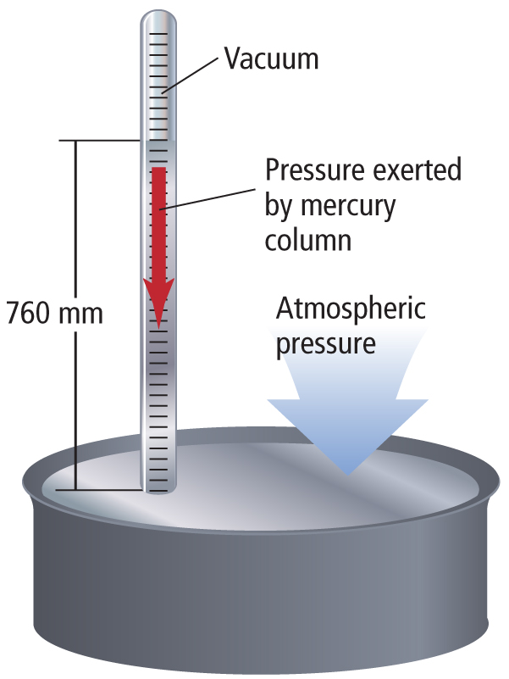
Gas Pressure
Barometers are instruments used to measure atmospheric air pressure.
Gases
Copyright © McGraw-Hill Education

Slide 12
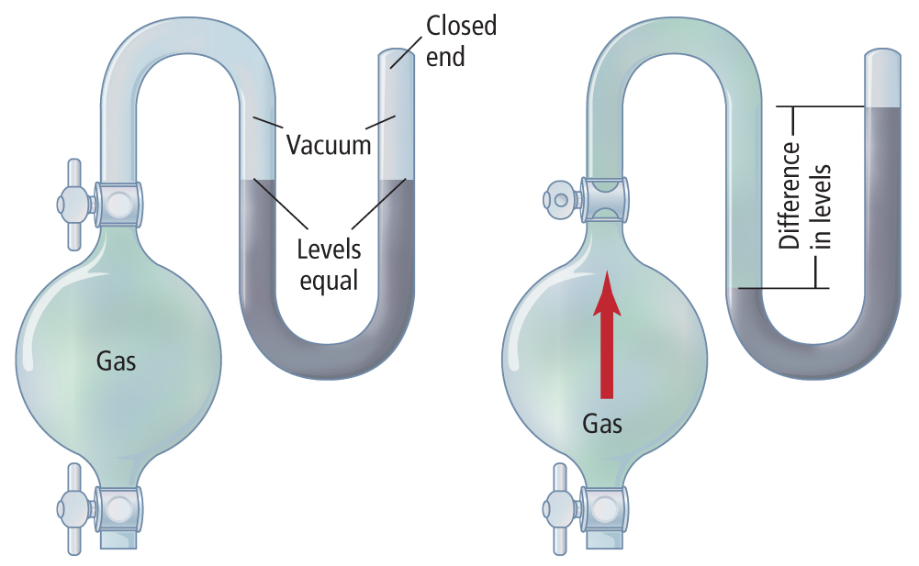
Gas Pressure
Manometers measure gas pressure in a closed container.
Gases
Copyright © McGraw-Hill Education

Slide 13
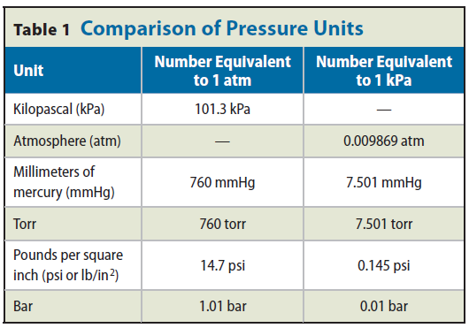
Units of Pressure
The SI unit of force is the newton (N).
One pascal(Pa) is equal to a force of one Newton per square meter or N/m².
One atmosphere is equal to 760 mm Hg or 101.3 kilopascals.
Gases
Copyright © McGraw-Hill Education

Slide 14
Dalton’s Law of Partial Pressures
Dalton’s law of partial pressures states that the total pressure of a mixture of gases is equal to the sum of the pressures of all the gases of the mixture.
The partial pressure of a gas depends on the number of moles, size of the container, and temperature and is independent of the type of gas.
At a given temperature and pressure, the partial pressure of 1mol of any gas is the same.
Gases
Copyright © McGraw-Hill Education

Slide 15
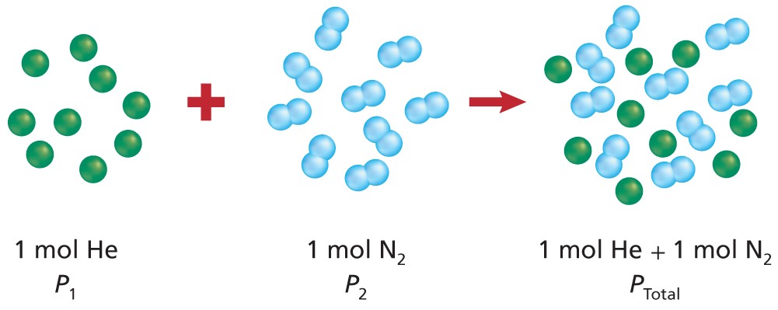
Dalton’s Law of Partial Pressures
Partial pressure can be used to calculate the amount of gas produced in a chemical reaction.
P_{total} = P₁ + P₂ + P₃ +...P_{n}
Gases
Copyright © McGraw-Hill Education

Slide 16
Partial Pressure of a Gas Example
A mixture of oxygen (O₂), carbon dioxide (CO₂), and nitrogen (N₂) has a total pressure of 0.97 atm. What is the partial pressure of O₂ if the partial pressure of CO₂ is 0.70 atm and the partial pressure of N₂ is 0.12 atm?
P_{total} = P_{N2} + P_{CO2} + P_{O2}
P_{O2} = P_{total} - P_{CO2} - P_{N2}
P_{O2} = 0.15 atm
KNOWN | UNKNOWN
P_{N2} = 0.12 atm | P_{O2} = ? atm
P_{CO2} = 0.70 atm
P_{total} = 0.97 atm
Gases
Copyright © McGraw-Hill Education

Slide 17
Essential Questions
What are the relationships between pressure, temperature, and volume of a constant amount of gas?
How can you use the gas laws to solve problems involving the pressure, temperature, and volume of a constant amount of gas?
The Gas Laws
Copyright © McGraw-Hill Education

Slide 18
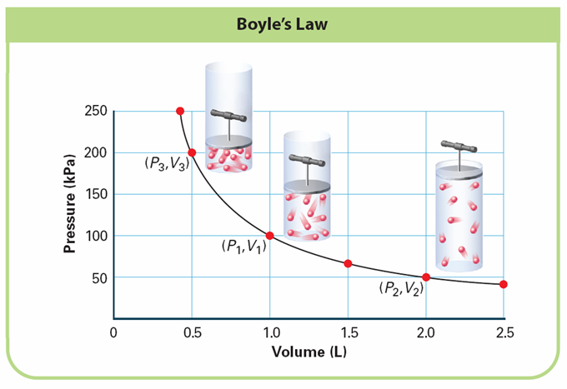
Boyle’s Law
Pressure goes up, volume goes down;
Pressure goes down, volume goes up.
Equation: P₁V₁ = P₂V₂
where P = pressure and V = volume
The Gas Laws
Copyright © McGraw-Hill Education

Slide 19
Boyle’s Law Example
A diver blows a 0.75-L air bubble 10 m under water. As it rises to the surface, the pressure goes from 2.25 atm to 1.03 atm. What will be the volume of air in the bubble at the surface?
P₁V₁ = P₂V₂
V₂ = V₁ $\left(\frac{\text{P}\text{1}}{\text{P}\text{2}}\right)$
V₂ = 0.75 L $\left(\frac{\text{2.25 }\text{atm}}{\text{1.03 }\text{atm}}\right)$
V₂ = 0.75 L $\left(\frac{\text{2.25 }\text{atm}}{\text{1.03 }\text{atm}}\right)$ =1.6 L
KNOWN | UNKNOWN
V₁ = 0.75 L | V₂ = ? L
P₁ = 2.25 atm
P₂ = 1.03 atm
The Gas Laws
Copyright © McGraw-Hill Education

Slide 20
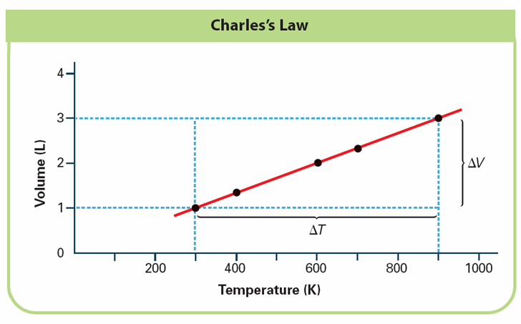
Charles’s Law
As temperature increases, so does the volume of gas when the amount of gas and pressure do not change.
Kinetic-molecular theory explains this property.
The Gas Laws
Copyright © McGraw-Hill Education

Slide 21
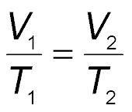
Charles’s Law
Charles’s law states that the volume of a given amount of gas is directly proportional to its kelvin temperature at constant pressure.
The Gas Laws
Copyright © McGraw-Hill Education

Slide 22
Charles’s Law Example
A helium balloon in a closed car occupies a volume of 2.32 L at 40.0°C. If the car is parked on a hot day and the temperature inside rises to 75.0°C, what is the new volume of the balloon, assuming the pressure remains constant?
T_{K} = 273 + T_{C}
T ₁ = 273 + 40.0°C = 313.0 K
T₂ = 273 + 75.0°C = 348.0 K
$\frac{\text{V}\text{1}}{\text{T}\text{1}}$ = $\frac{\text{V}\text{2}}{\text{T}\text{2}}$ → $\text{V}\text{2 }$= $\text{V}\text{1}$ $\frac{\text{T}\text{2}}{\text{T}\text{1}}$
V₂ = 2.32 L $\left(\frac{\text{348.0 }\text{K}}{\text{313.0 }\text{K}}\right)$
V₂ = 2.32 L $\left(\frac{\text{348.0 }\text{K}}{\text{313.0 }\text{K}}\right)$= 2.58 L
KNOWN | UNKNOWN
T₂ = 40.0°C | V₂ = ? L
V₁ = 2.32 L
T₂ = 75.0°C
The Gas Laws
Copyright © McGraw-Hill Education

Slide 23
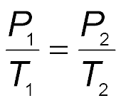
Gay-Lussac’s Law
Gay-Lussac’s law states that the pressure of a fixed amount of gas varies directly with the kelvin temperature when the volume remains constant.
The Gas Laws
Copyright © McGraw-Hill Education

Slide 24
Gay-Lussac’s Law Example
The pressure of the oxygen gas inside a canister is 5.00 atm at 25.0°C. The canister is located at a camp high on Mount Everest. If the temperature there falls to -10.0°C, what is the new pressure inside the canister?
T_{K} = 273 + T_{C}
T₁ = 273 + 25.0°C = 298.0 K
T₂ = 273 + (-10.0°C) = 263.0 K
$\frac{\text{P}\text{1}}{\text{T}\text{1}}$ = $\frac{\text{P}\text{2}}{\text{T}\text{2}}$ → P₂ = P₁$\left(\frac{\text{T}\text{2}}{\text{T}\text{1}}\right)$
P₂ = 5.00 atm $\left(\frac{\text{263.0 }\text{K}}{\text{298.0 }\text{K}}\right)$
P₂ = 5.00 atm $\left(\frac{\text{263.0 }\text{K}}{\text{298.0 }\text{K}}\right)$= 4.41 atm
KNOWN | UNKNOWN
P₁ = 5.00 atm | P₂ = ? atm
T₁ = 25.0°C
T₂ = -10.0°C
The Gas Laws
Copyright © McGraw-Hill Education

Slide 25
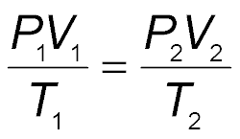
Combined Gas Law
The combined gas law states the relationship among pressure, temperature, and volume of a fixed amount of gas.
The Gas Laws
Copyright © McGraw-Hill Education

Slide 26
Combined Gas Law Example
A gas at 110 kPa and 30.0°C fills a flexible container with an initial volume of 2.00 L. If the temperature is raised to 80.0°C and the pressure increases to 440 kPa, what is the new volume?
T_{K} = 273 + TC
T₁ = 273 + 30.0°C = 303.0 K
T₂ = 273 + 80.0°C = 353.0 K
$\frac{\text{P}\text{1}\text{V}\text{1}}{\text{T}\text{1}}$ = $\frac{\text{P}\text{2} \text{V}\text{2}}{\text{T}\text{2 }}$ → V₂ = V₁ $\left(\frac{\text{P}\text{1}}{\text{P}\text{2}}\right)\left(\frac{\text{T}\text{2}}{\text{T}\text{1}}\right)$
V₂ = 2.00 L $\left(\frac{\text{110 }\text{kPa}}{\text{440 }\text{kPa}}\right)$ $\left(\frac{\text{353.0 }\text{K}}{\text{303.0 }\text{K}}\right)$
V₂ = 2.00 L $\left(\frac{\text{110 }\text{kPa}}{\text{440 }\text{kPa}}\right)$ $\left(\frac{\text{353.0 }\text{K}}{\text{303.0 }\text{K}}\right)$ = 0.58 L
KNOWN | UNKNOWN
P₁ = 110 kPa | V₂ = ? L
P₂ = 440 kPa
T₁ = 30.0ºC
T₂ = 80.0ºC
V₁ = 2.00 L
The Gas Laws
Copyright © McGraw-Hill Education

Slide 27
Essential Questions
How does Avogadro’s principle relate the number of particles of gas to the gas’s volume?
How is the amount of gas present related to its pressure, temperature, and volume by the ideal gas law?
What are the properties of real gases and of ideal gases?
The Ideal Gas Law
Copyright © McGraw-Hill Education

Slide 28
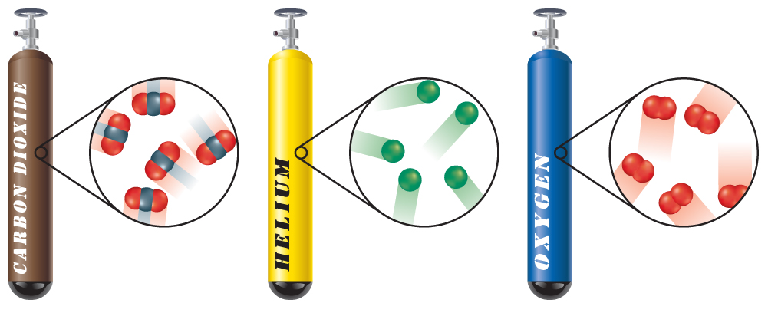
Avogadro’s Principle
Avogadro’s principle states that equal volumes of gases at the same temperature and pressure contain equal numbers of particles.
The Ideal Gas Law
Copyright © McGraw-Hill Education

Slide 29
Avogadro’s Principle
The molar volume of a gas is the volume 1 mol occupies at 0.00°C and 1.00 atm of pressure.
0.00°C and 1.00 atm are called standard temperature and pressure (STP).
At STP, 1 mol of gas occupies 22.4 L.
The Ideal Gas Law
Copyright © McGraw-Hill Education

Slide 30
Molar Volume Example
The main component of natural gas used for home heating and cooking is methane (CH₄). Calculate the volume that 2.00 kg of methane gas will occupy at STP.
2.00 kg$\left(\frac{\text{1000 }\text{g} }{\text{1 }\text{kg}}\right)$ = 2.00 × 10³ g
$\frac{\text{m}}{\text{M}}\text{=}\frac{\text{2.00 }\text{×}\text{ 103 }\text{g} }{\text{16.05 }\text{g}\text{/}\text{mol} }$ = 125 mol
Use the molar volume, 22.4 L/mol, to determine the volume of methane at STP.
V = 125 mol × $\frac{\text{22.4 }\text{L}}{\text{1 }\text{mo}\text{l}}$ = 2.80 × 10³ L
KNOWN | UNKNOWN
m = 2.00 kg | V = ? L
T = 0.00ºC
P = 1.00 atm
M = 16.05 g/mol
The Ideal Gas Law
Copyright © McGraw-Hill Education

Slide 31
Ideal Gas Law
Combined gas law to ideal gas law
Ideal gas particles occupy a negligible volume and are far enough apart to exert minimal attractive or repulsive forces on each other.
The Ideal Gas Law
Copyright © McGraw-Hill Education

Slide 32
Ideal Gas Law
The ideal gas constant is represented by R and is 0.0821 L•atm/mol•K when pressure is in atmospheres.
The ideal gas law describes the physical behavior of an ideal gas in terms of pressure, volume, temperature, and amount.
The Ideal Gas Law
Copyright © McGraw-Hill Education

Slide 33
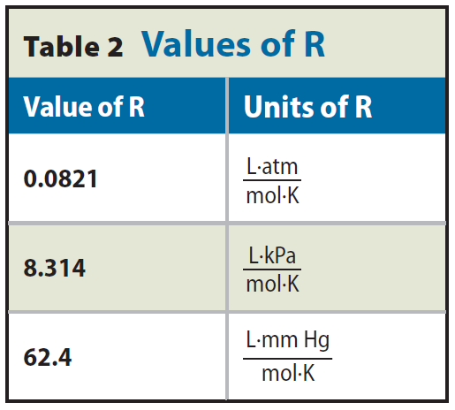
Ideal Gas Law
The Ideal Gas Law
Copyright © McGraw-Hill Education

Slide 34
Ideal Gas Law Example
Calculate the number of moles of ammonia gas (NH₃) contained in a 3.0-L vessel at 3.00 × 10² K with a pressure of 1.50 atm.
PV = nRT → n = $\frac{\text{PV}}{\text{RT}}$
n =$\frac{\text{(1.50 }\text{atm}\text{)(3.0 }\text{L}\text{)}}{\left(\text{0.0821 }\frac{\text{L}\text{·}\text{atm}}{\text{mol}\text{·}\text{K}}\right)\text{(3.00 }\text{×}\text{ 102 }\text{K}\text{)}}$
n =$\frac{\text{(1.50 }\text{atm}\text{)(3.0 }\text{L}\text{)}}{\left(\text{0.0821 }\frac{\text{L}\text{·}\text{atm}}{\text{mol}\text{·}\text{K}}\right)\text{(3.00 }\text{×}\text{ 102 }\text{K}\text{)}}$ = 0.18 mol
KNOWN | UNKNOWN
V = 3.0 L | n = ? mol
T = 3.00 × 10² K
P = 1.50 atm
R = 0.0821 $\frac{\text{L}\text{·}\text{atm} }{\text{mol}\text{·}\text{K}}$
The Ideal Gas Law
Copyright © McGraw-Hill Education

Slide 35
Ideal Gas Law—Molar Mass
The Ideal Gas Law
Copyright © McGraw-Hill Education

Slide 36
Ideal Gas Law—Density
The Ideal Gas Law
Copyright © McGraw-Hill Education

Slide 37
Real Versus Ideal Gases
Ideal gases follow the assumptions of the kinetic-molecular theory.
Characteristics of ideal gases:
There are no intermolecular attractive or repulsive forces between particles or with their containers.
The particles are in constant random motion.
Collisions are perfectly elastic.
No gas is truly ideal, but most behave as ideal gases at a wide range of temperatures and pressures.
The Ideal Gas Law
Copyright © McGraw-Hill Education

Slide 38
Real Versus Ideal Gases
Real gases deviate most from ideal gases at high pressures and low temperatures.
Polar molecules have larger attractive forces between particles.
Polar gases do not behave as ideal gases.
Large nonpolar gas particles occupy more space and deviate more from ideal gases.
The Ideal Gas Law
Copyright © McGraw-Hill Education

Slide 39
Essential Questions
What stoichiometric ratios can be determined for gaseous reactants and products from balanced chemical equations?
How are the amounts of gaseous reactants and products in a chemical reaction calculated?
Gas Stoichiometry
Copyright © McGraw-Hill Education

Slide 40
Stoichiometry of Gas Reactions
The gas laws can be applied to calculate the stoichiometry of reactions in which gases are reactants or products.
2H₂(g) + O₂(g) → 2H₂O(g)
2 mol H₂ reacts with 1 mol O₂ to produce 2 mol water vapor.
Gas Stoichiometry
Copyright © McGraw-Hill Education

Slide 41
Stoichiometry and Volume–Volume Problems
Coefficients in a balanced equation represent volume ratios for gases.
A balanced chemical equation allows you to find ratios for only moles and gas volumes, not for masses.
All masses given must be converted to moles or volumes before being used as part of a ratio.
Gas Stoichiometry
Copyright © McGraw-Hill Education

Slide 42
Volume-Volume Problems
What volume of oxygen gas is needed for the complete combustion of 4.00 L of propane gas (C₃H₈)? Assume that pressure and temperature remain constant.
$$\frac{\text{5 }\text{volumes} \text{O}\text{2} }{\text{1 }\text{volume} \text{C}\text{3}\text{H}\text{8} }$$
V_{O2} = (4.00 L C₃H₈) × $\frac{\text{5 }\text{volumes} \text{O}\text{2}}{\text{1 }\text{volume} \text{C}\text{3}\text{H}\text{8} }$
= 20.0 L O₂
KNOWN | UNKNOWN
V_{C3H8}= 4.00 L | V₀₂ = ? L
C₃H₈ (g) + 5 O₂ (g) → 3 CO₂ (g) + 4 H₂O(g)
Gas Stoichiometry
Copyright © McGraw-Hill Education

Slide 43
Volume-Mass Problems
Ammonia is synthesized from hydrogen and nitrogen.
N₂(g) + 3 H₂(g)→2NH₃(g)
If 5.00 L of nitrogen reacts completely with hydrogen at a pressure of 3.00 atm and a temperature of 298 K, how much ammonia, in grams, is produced?
5.00 L N₂ $\left(\frac{\text{2 }\text{volumes} \text{NH}\text{3}}{\text{1 }\text{volume} \text{N}\text{2}}\right)$ = 10.0 L NH₃
PV = nRT → $n= \frac{PV}{RT}$
$n=\frac{\left(3.00 atm\right)(10.0 L)}{(0.0821\left(\frac{L∙atm}{mol∙K}\right)\left(298 K\right)}$= 1.23 mol NH₃
KNOWN | UNKNOWN
V_{N2} = 5.00 L | m_{NH3} = ? g
P = 3.00 atm
T = 298 K
M = 17.04 g/mol
$$\text{1.23 }\text{mol} \text{NH}\text{3} \text{×} \frac{\text{17.04 }\text{g} \text{NH}\text{3}}{\text{1 }\text{mol} \text{NH}\text{3}} \text{= }\text{21.0 }\text{g}$$
Gas Stoichiometry
Copyright © McGraw-Hill Education

