Slide 1
Development of the Periodic Table
Meyer and Mendeleev both demonstrated a connection between atomic mass and elemental properties.
Mendeleev arranged the table by properties and then atomic mass.
Moseley rearranged the table by increasing atomic number.
Periodic law - Periodic repetition of chemical and physical properties of the elements when they are arranged by increasing atomic number
Development of the Modern Periodic Table
Copyright © McGraw-Hill Education

Slide 2
The Modern Periodic Table
Columns = groups.
Rows = periods.
Elements in groups 1,2, and 13–18
Have a wide variety of chemical and physical properties
Representative elements.
Elements in groups 3–12
Transition metals.
Development of the Modern Periodic Table
Copyright © McGraw-Hill Education

Slide 3
The Modern Periodic Table
Elements are classified as metals, nonmetals, and metalloids.
Metals are elements that are generally shiny, solid at room temperature, and good conductors of heat and electricity.
Nonmetals are elements that are generally gases or brittle, dull-looking solids, and poor conductors of heat and electricity.
Metalloids have physical and chemical properties of both metals and nonmetals.
Development of the Modern Periodic Table
Copyright © McGraw-Hill Education

Slide 4
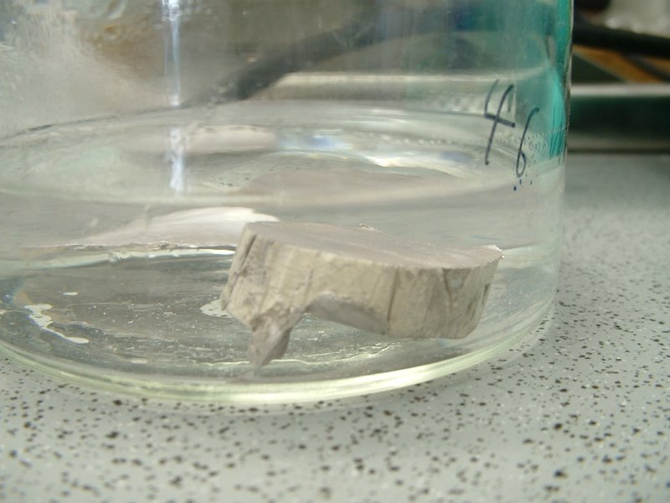
ELEMENT CLASSES

Slide 5
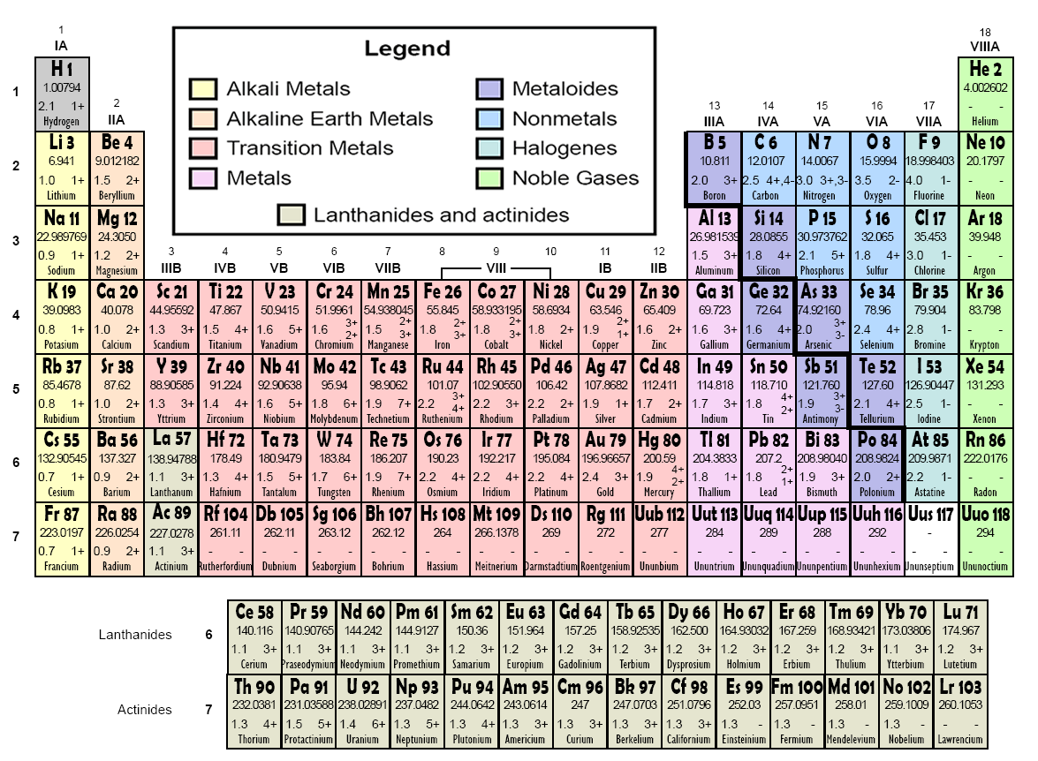

Slide 6
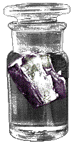
Alkali Metals
All alkali metals have 1 valence electron
Alkali metals are NEVER found pure in nature; they are too reactive
Reactivity of these elements increases down the group
Potassium, K reacts with water and must be stored in kerosene

Slide 7
Alkaline Earth Metals
All alkaline earth metals have 2 valence electrons
Alkaline earth metals are less reactive than alkali metals
Alkaline earth metals are not found pure in nature; they are too reactive
The word “alkaline” means “basic”
common bases include salts of the metals
Ca(OH)₂
Mg(OH)₂

Slide 8
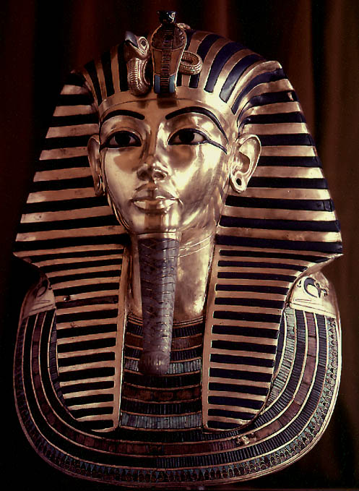
Properties of Metals
Metals are good conductors of heat and electricity
Metals are malleable
Metals are ductile
Metals have high tensile strength
Metals have luster

Slide 9
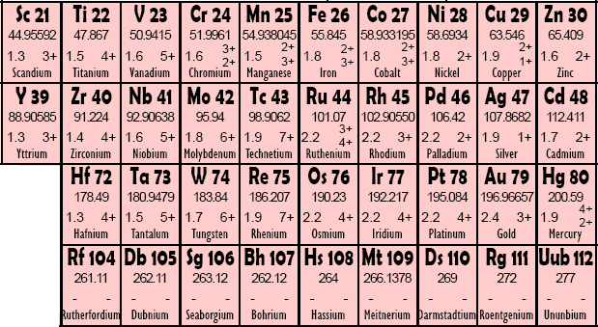
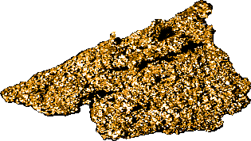
Transition Metals
Copper, Cu, is a relatively soft metal, and a very good electrical conductor.
Mercury, Hg, is the only metal that exists as a liquid at room temperature

Slide 10
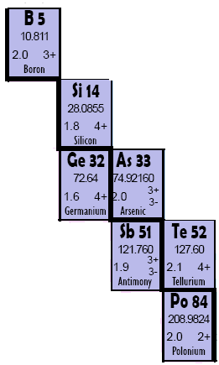
Properties of Metalloids
They have properties of both metals and nonmetals.
Metalloids are more brittle than metals, less brittle than most nonmetallic solids
Metalloids are semiconductors of electricity
Some metalloids possess metallic luster

Slide 11
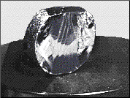
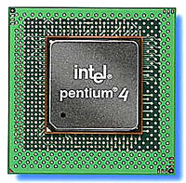
Silicon, Si – A Metalloid
Silicon has metallic luster
Silicon is brittle like a nonmetal
Silicon is a semiconductor of electricity
Other metalloids include:
Boron, B
Germanium, Ge
Arsenic, As
Antimony, Sb
Tellurium, Te

Slide 12
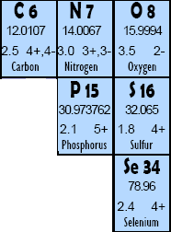
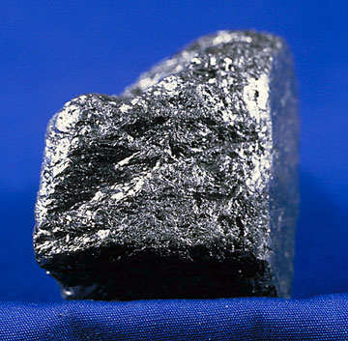
Nonmetals
Nonmetals are poor conductors of heat and electricity
Nonmetals tend to be brittle
Many nonmetals are gases at room temperature
Carbon, the graphite in “pencil lead” is a great example of a nonmetallic element.

Slide 13
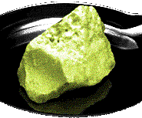
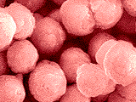
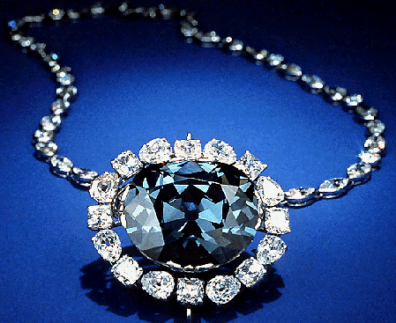
Examples of Nonmetals
Microspheres of phosphorus, P, a reactive nonmetal
Sulfur, S, was once known as “brimstone”
Graphite is not the only pure form of carbon, C. Diamond is also carbon; the color comes from impurities caught within the crystal structure

Slide 14
Halogens
Halogens all have 7 valence electrons
Halogens are never found pure in nature; they are too reactive
Halogens in their pure form are diatomic molecules (F₂, Cl₂, Br₂, and I₂)
Chlorine is a yellow-green poisonous gas

Slide 15
Noble Gases
Noble gases have 8 valence electrons (except helium, which has only 2)
Noble gases are ONLY found pure in nature – they are chemically unreactive
Colorless, odorless and unreactive; they were among the last of the natural elements to be discovered

Slide 16
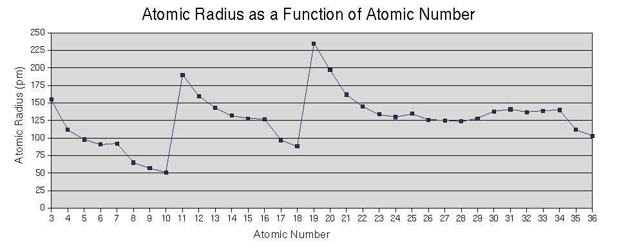
Periodic Trends

Slide 17
Atomic Radius
Definition: Half of the distance between nuclei in covalently bonded diatomic molecule
Radius decreases across a period
Increased effective nuclear charge due to decreased shielding
Radius increases down a group
Each row on the periodic table adds a “shell” or energy level to the atom

Slide 18
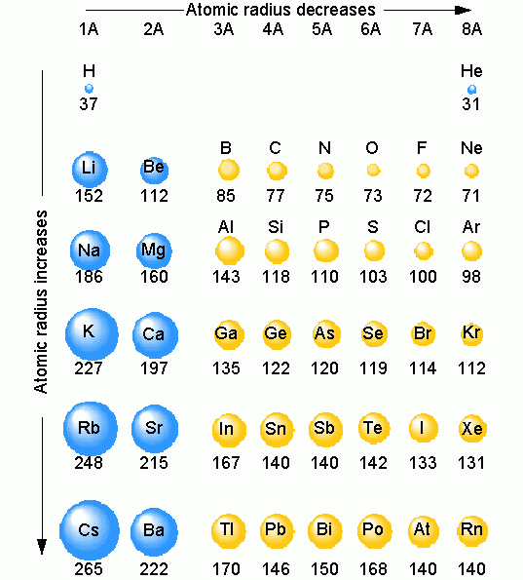
Table of Atomic Radii

Slide 19
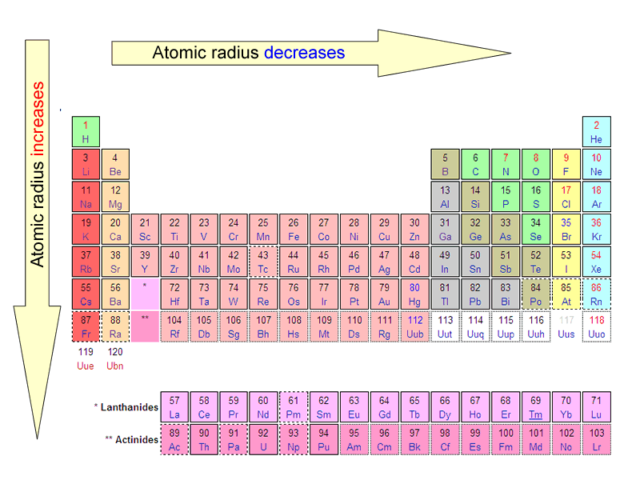
Period Trend: Atomic Radius

Slide 20
Ionization Energy
Definition: the energy required to remove an electron from an atom
Tends to increase across a period
As radius decreases across a period, the electron you are removing is closer to the nucleus and harder to remove
Tends to decrease down a group
Outer electrons are farther from the nucleus and easier to remove

Slide 21
Periodic Trend: Ionization Energy

Slide 22
Electronegativity
Definition: A measure of the ability of an atom in a chemical compound to attract electrons
Electronegativity tends to increase across a period
As radius decreases, electrons get closer to the bonding atom’s nucleus
Electronegativity tends to decrease down a group or remain the same
As radius increases, electrons are farther from the bonding atom’s nucleus

Slide 23
Periodic Table of Electronegativities

Slide 24
Periodic Trend: Electronegativity

Slide 25
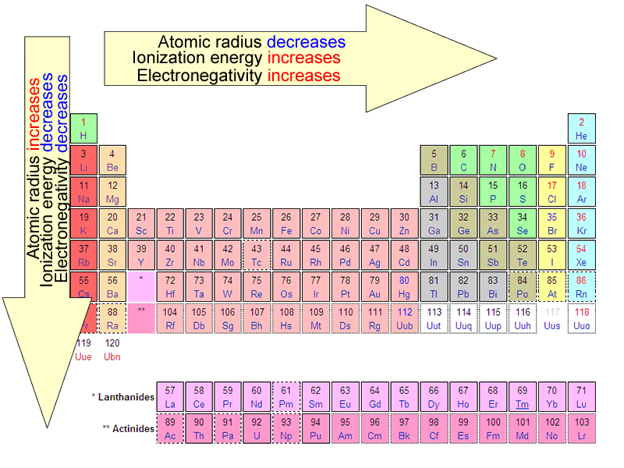
Summary of Periodic Trends

Slide 26
Ionic Radii
Positively charged ions formed when
an atom of a metal loses one or
more electrons
Cations
Smaller than the corresponding
atom
Negatively charged ions formed
when nonmetallic atoms gain one
or more electrons
Anions
Larger than the corresponding
atom

Slide 27
Graphic courtesy Wikimedia Commons user Popnose

Slide 28
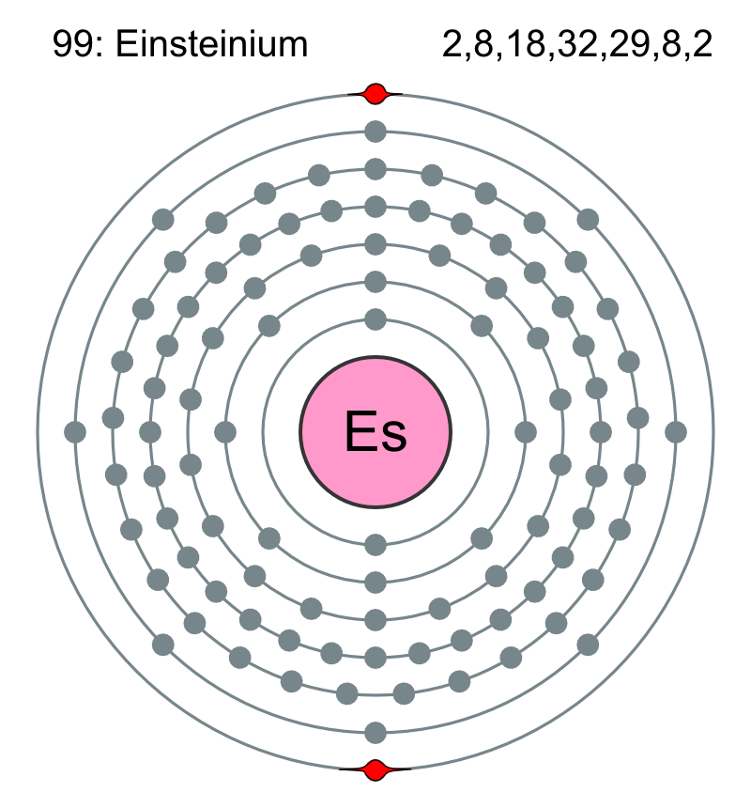
Valence Electrons:
ELECTRONS AVAILABLE FOR BONDING

Slide 29
Definition
Valence electrons are electrons in the outmost shell (energy level). They are the electrons available for bonding.

Slide 30
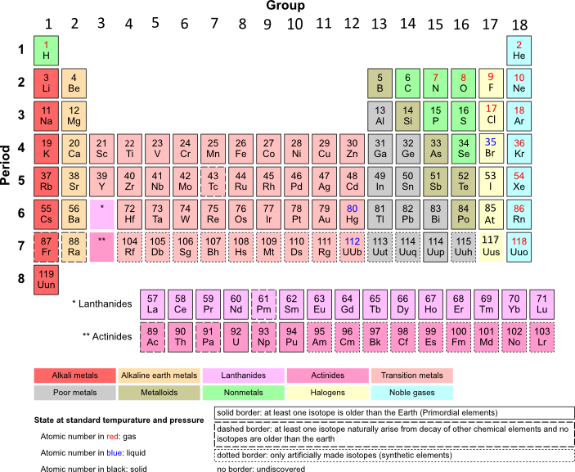
Group 1 (alkali metals) have 1 valence electron

Slide 31
Group 2 (alkaline earth metals) have 2 valence electrons

Slide 32
Group 13 elements have 3 valence electrons

Slide 33
Group 14 elements have 4 valence electrons

Slide 34
Group 15 elements have 5 valence electrons

Slide 35
Group 16 elements have 6 valence electrons

Slide 36
Group 17 (halogens) have 7 valence electrons

Slide 37
Group 18 (Noble gases) have 8 valence electrons, except helium, which has only 2

Slide 38
Transition metals (“d” block) have 1 or 2 valence electrons

Slide 39
Lanthanides and actinides
(“f” block) have 1 or 2 valence electrons

Slide 40
Dot Notations
An atom’s valence electrons can be represented by Lewis dot notations.
1 valence e⁻ X | 2 valence e⁻ X | 3 valence e⁻ X | 4 valence e⁻ X
5 valence e⁻ X | 6 valence e⁻ X | 7 valence e⁻ X | 8 valence e⁻ X

Slide 41
Dot Notations – Period 2
Lewis dot notations for the valence electrons of the elements of Period 2.
lithium Li | beryllium Be | boron B | carbon C
nitrogen N | oxygen O | fluorine F | neon Ne

Slide 42
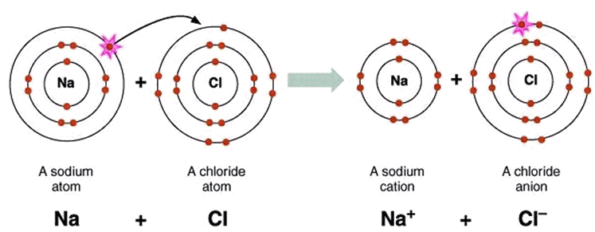
Ionic Bonding

Slide 43
Bonds
Forces that hold groups of atoms
together and make them function
as a unit.
Ionic bonds – transfer of electrons
Covalent bonds – sharing of electrons

Slide 44
The Octet Rule – Ionic Compounds
Ionic compounds form so that each atom, by gaining or losing electrons, has an octet of electrons in its highest occupied energy level.
Metals lose electrons to form positively-charged cations
Nonmetals gains electrons to form negatively-charged anions

Slide 45
Ionic Bonding: The Formation of Sodium Chloride
Sodium has 1 valence electron
Chlorine has 7 valence electrons
An electron transferred gives
each an octet
Na: 1s²2s²2p⁶3s¹
Cl: 1s²2s²2p⁶3s²3p⁵

Slide 46
Ionic Bonding: The Formation of Sodium Chloride
This transfer forms ions, each with an octet:
Na⁺ 1s²2s²2p⁶
Cl⁻ 1s²2s²2p⁶3s²3p⁶

Slide 47
Ionic Bonding: The Formation of Sodium Chloride
The resulting ions come together due to electrostatic attraction
(opposites attract):
Na⁺
Cl⁻
The net charge on the compound must equal zero

Slide 48
Examples of Ionic compounds
Mg²⁺Cl⁻₂
Magnesium chloride: Magnesium loses two electrons and each chlorine gains one electron
Na⁺₂O²⁻
Sodium oxide: Each sodium loses one electron and the oxygen gains two electrons
Al³⁺₂S²⁻₃
Aluminum sulfide: Each aluminum loses two electrons (six total) and each sulfur gains two electrons (six total)

Slide 49
Metal | Monatomic Cations | Ion name
Lithium | Li⁺ | Lithium
Sodium | Na⁺ | Sodium
Potassium | K⁺ | Potassium
Magnesium | Mg²⁺ | Magnesium
Calcium | Ca²⁺ | Calcium
Barium | Ba²⁺ | Barium
Aluminum | Al³⁺ | Aluminum

Slide 50
Nonmetal | Monatomic Anions | Ion Name
Fluorine | F⁻ | Fluoride
Chlorine | Cl⁻ | Chloride
Bromine | Br⁻ | Bromide
Iodine | I⁻ | Iodide
Oxygen | O²⁻ | Oxide
Sulfur | S²⁻ | Sulfide
Nitrogen | N³⁻ | Nitride
Phosphorus | P³⁻ | Phosphide

Slide 51
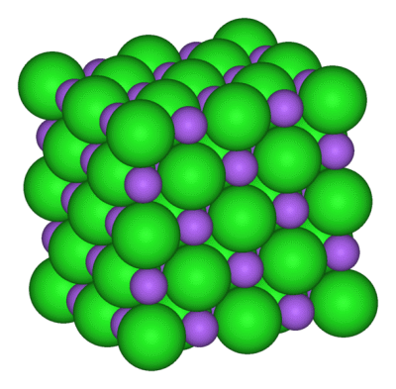
Sodium Chloride Crystal Lattice
Ionic compounds form solid crystals at ordinary temperatures.
Ionic compounds organize in a characteristic crystal lattice of alternating positive and negative ions.
All salts are ionic compounds and form crystals.

Slide 52
Properties of Ionic Compounds
Structure: | Crystalline solids
Melting point: | Generally high
Boiling Point: | Generally high
Electrical Conductivity: | Excellent conductors, molten and aqueous
Solubility in water: | Generally soluble

Slide 53
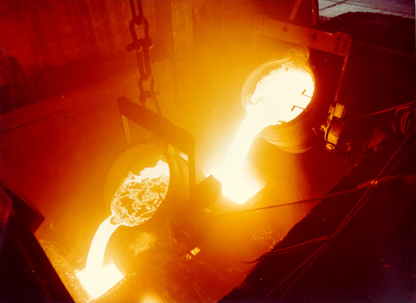
Metallic Bonding
Strong forces of attraction are responsible for the high melting point of most metals.

Slide 54
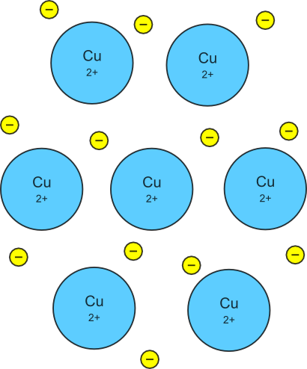
Metallic Bonding
The chemical bonding that results from the attraction between metal cations and the surrounding sea of electrons
Vacant p and d orbitals in metal's outer energy levels overlap, and allow outer electrons to move freely throughout the metal
Valence electrons do not belong to any one atom

Slide 55
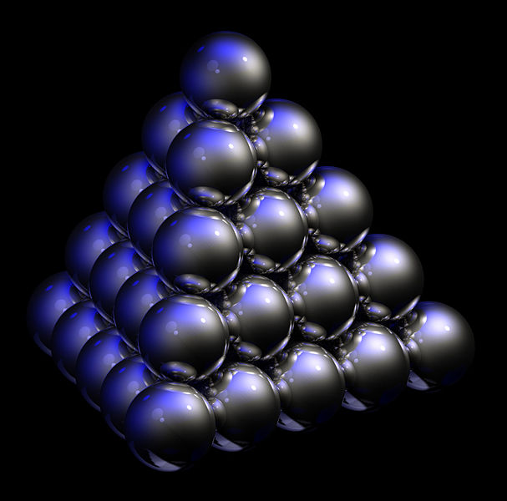
Packing in Metals
Model: Packing uniform, hard spheres to best use available space. This is called closest packing. Each atom has 12 nearest neighbors.

Slide 56
Metal Alloys
Substitutional Alloy: some metal atoms replaced by others of similar size.

Slide 57
Metal Alloys
Interstitial Alloy: Interstices (holes) in closest packed metal structure are occupied by small atoms.

Slide 58
Properties of Metals
Metals are good conductors of heat and electricity
Metals are malleable
Metals are ductile
Metals have high tensile strength
Metals have luster

