Slide 1
The Lab Report
www.lab-initio.com

Slide 2
Lab Report Format
Title Date Full names, author first Class period Instructor Abstract:
Procedure: Results:

Slide 3
Procedure
The procedure begins on the second page of the lab report.
The procedure SHOULD NOT be a copy of the written procedure in the lab document.
It SHOULD be a summary of important steps, directions, materials and equipment.

Slide 4
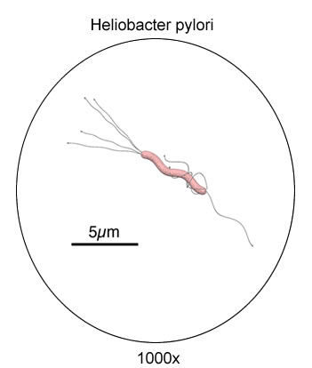
Results - Diagrams
Title
Labels
Includes and/or scale magnification, if appropriate

Slide 5
Results - Data
Data presented in tables
Table given a title
Columns/rows labeled with quantity and dimensions
Results of Recrystallization
Test tube # | Grams KNO₃/1.0 ml H₂O | crystallization temperature (°C)
1 | 0.400 | 25
2 | 0.600 | 37
3 | 0.800 | 49
4 | 1.000 | 65

Slide 6
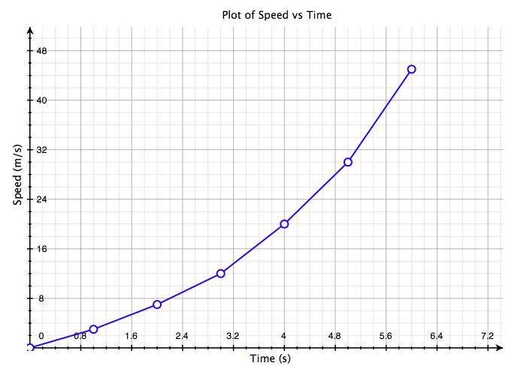
Results - Graphs
Titled
Both axes labeled with quantity and dimension
Appropriate scale used on both axes
Graph accurately represents data and uses a best fitting curve when appropriate

Slide 7
The Abstract
It summarizes the contents of the research paper/laboratory report
It is written so that someone without a science background can understand it.
It is concise – usually no more than a paragraph
It appears at the beginning of the report, so that the reader can decide if they have interest in reading the entire paper.

Slide 8
Five Essential Components
Background – Define important concepts, theories or laws being examined.
Statement of Purpose – What were you attempting to do in this experiment?
Summary of Procedure – What methods did you use to complete this investigation? This should be a summary, not a detailed procedure like the one you completed in the body of the report.
Summary of Results – What happened? Summarize observations and results of calculations and graphs.
Significance of Findings – What important concepts or theories are reinforced by your results? What experimental errors or limitations might have negatively influenced your results?

Slide 9
The Sweet Spot of a Baseball Bat
Abstract:
The sweet spot of a baseball bat, like that of a tennis racket, can be defined either in terms of a vibration node or a centre of percussion. In order to determine how each of the sweet spots influences the “feel” of the bat, measurements were made of the impact forces transmitted to the hands. Measurements of the bat velocity, and results for a freely suspended bat, were also obtained in order to assist in the interpretation of the force waveforms. The results show that both sweet spots contribute to the formation of a sweet spot zone where the impact forces on the hands are minimized. The free bat results are also of interest since they provided particularly elegant examples of wave excitation and propagation, suitable for a student demonstration or experiment.
Rod Cross, Am. J. Phys. 66, 772 (1998)

Slide 10
Do Cathedral Glasses Flow?
Abstract:
A general belief among members of the scientific community is that glass articles can be bent irreversibly and that they flow at ambient temperature. This myth is mostly based on widespread stories that stained-glass windows of medieval cathedrals are thicker in the lower parts. In this paper I estimate the time periods required for glass to flow and deform at ordinary temperatures, using calculated viscosity curves for several modern and ancient glass compositions. The conclusion is that window glasses may flow at ambient temperature only over incredibly long times, which exceed the limits of human history.
Edgar Dutra Zanotto. Am. J. Phys. 66, 392 (1998)

Slide 11
Genetic Detection and Characterization of Lujo Virus, a New Hemorrhagic Fever–Associated Arenavirus from Southern Africa
Abstract
Lujo virus (LUJV), a new member of the family Arenaviridae and the first hemorrhagic fever–associated arenavirus from the Old World discovered in three decades, was isolated in South Africa during an outbreak of human disease characterized by nosocomial transmission and an unprecedented high case fatality rate of 80% (4/5 cases). Unbiased pyrosequencing of RNA extracts from serum and tissues of outbreak victims enabled identification and detailed phylogenetic characterization within 72 hours of sample receipt. Full genome analyses of LUJV showed it to be unique and branching off the ancestral node of the Old World arenaviruses. The virus G1 glycoprotein sequence was highly diverse and almost equidistant from that of other Old World and New World arenaviruses, consistent with a potential distinctive receptor tropism. LUJV is a novel, genetically distinct, highly pathogenic arenavirus.
PLOS Pathogens, May 2009

Slide 12
Sensory Ataxic Neuropathy in Golden Retriever Dogs Is Caused by a Deletion in the Mitochondrial tRNA^{Tyr} Gene
Abstract:
Sensory ataxic neuropathy (SAN) is a recently identified neurological disorder in golden retrievers. Pedigree analysis revealed that all affected dogs belong to one maternal lineage, and a statistical analysis showed that the disorder has a mitochondrial origin. A one base pair deletion in the mitochondrial tRNA^{Tyr} gene was identified at position 5304 in affected dogs after re-sequencing the complete mitochondrial genome of seven individuals. The deletion was not found among dogs representing 18 different breeds or in six wolves, ruling out this as a common polymorphism. The mutation could be traced back to a common ancestor of all affected dogs that lived in the 1970s. We used a quantitative oligonucleotide ligation assay to establish the degree of heteroplasmy in blood and tissue samples from affected dogs and controls. Affected dogs and their first to fourth degree relatives had 0–11% wild-type (wt) sequence, while more distant relatives ranged between 5% and 60% wt sequence and all unrelated golden retrievers had 100% wt sequence. Northern blot analysis showed that tRNA^{Tyr} had a 10-fold lower steady-state level in affected dogs compared with controls. Four out of five affected dogs showed decreases in mitochondrial ATP production rates and respiratory chain enzyme activities together with morphological alterations in muscle tissue, resembling the changes reported in human mitochondrial pathology. Altogether, these results provide conclusive evidence that the deletion in the mitochondrial tRNA^{Tyr} gene is the causative mutation for SAN.
PLOS Genetics, May 2009

