Slide 1
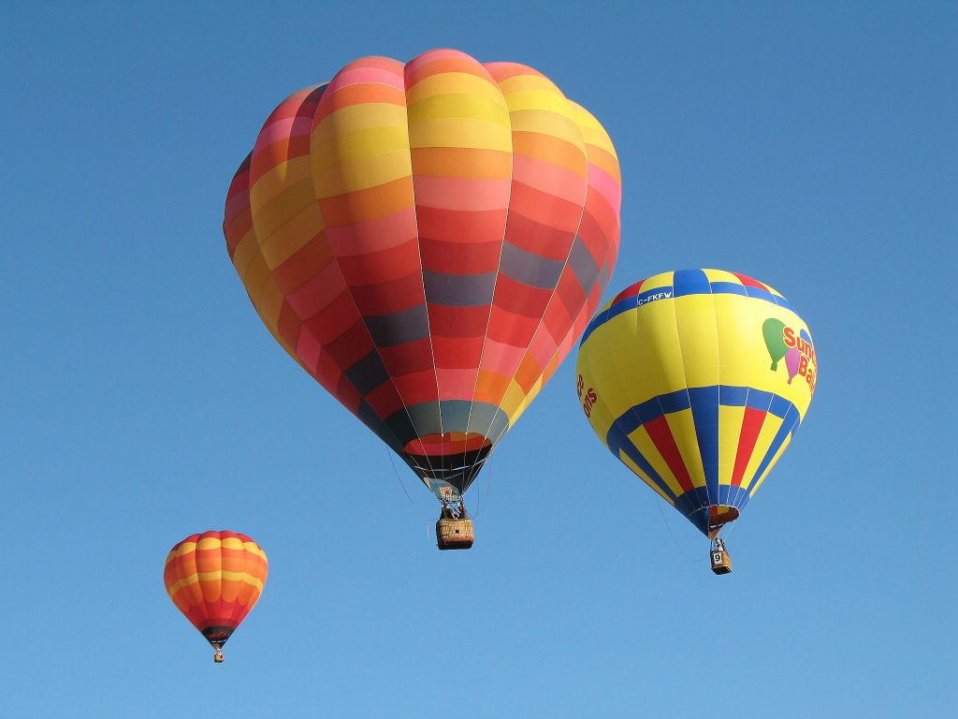
Gases

Slide 2
The Nature of Gases
Gases expand to fill their containers
Gases are fluid – they flow
Gases have low density
1/1000 the density of the equivalent liquid or solid
Gases are compressible
Gases effuse and diffuse

Slide 3
Ideal Gases
Ideal gases are imaginary gases that perfectly
fit all of the assumptions of the kinetic molecular theory.
Gases consist of tiny particles that are far apart relative to their size.
Collisions between gas particles and between
particles and the walls of the container are
elastic collisions
No kinetic energy is lost in elastic collisions

Slide 4
Ideal Gases (continued)
Gas particles are in constant, rapid motion.
They therefore possess kinetic energy, the
energy of motion
There are no forces of attraction
between gas particles
The average kinetic energy of gas
particles depends on temperature, not
on the identity of the particle.

Slide 5
Pressure
Pressure is the force created by the collisions
of molecules with the walls of a container
Unit | Symbol | Definition/Relationship
Pascal | Pa | SI pressure unit 1 Pa = 1 newton/meter²
Millimeter of mercury | mm Hg | Pressure that supports a 1 mm column of mercury in a barometer
Atmosphere | atm | Average atmospheric pressure at sea level and 0 °C
Torr | torr | 1 torr = 1 mm Hg

Slide 6
Standard Pressure
1 standard atmosphere (atm)
101.3 kPa (kilopascals)
14.7 lbs/in2
760 mm Hg (millimeters of mercury)
760 torr

Slide 7
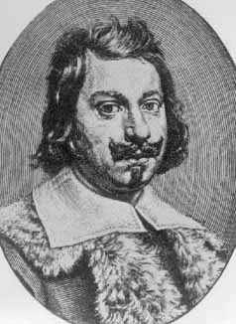
Measuring Pressure
The first device for measuring atmospheric
pressure was developed by Evangelista Torricelli
during the 17th century.
The device was called a “barometer”
Baro = weight
Meter = measure

Slide 8
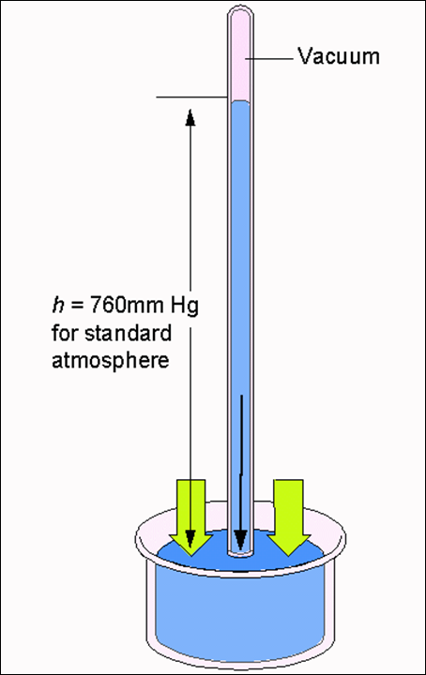
An Early Barometer
The normal pressure due to the atmosphere at sea level can support a column of mercury that is 760 mm high.

Slide 9
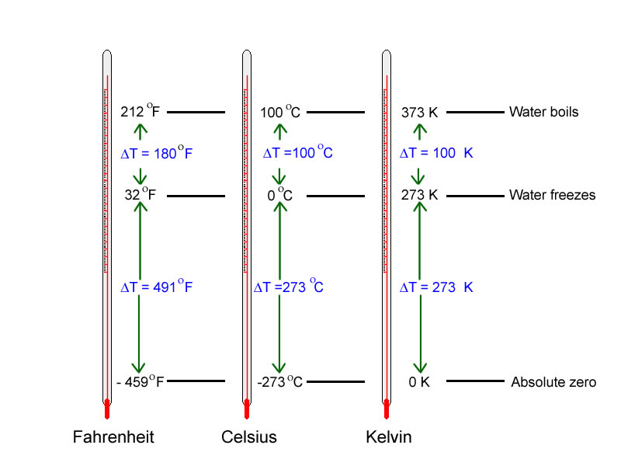
The Kelvin Scale

Slide 10
Standard Temperature and Pressure “STP”
Either of these:
273 Kelvin (273 K)
0 °C
And any one of these:
1 atm
101.3 kPa
14.7 lbs/in² (psi)
760 mm Hg
760 torr

