Slide 1
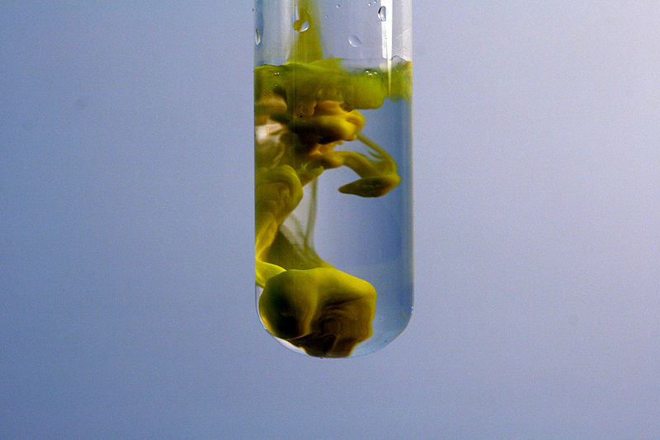
Solubility Equilibria
Lead (II) iodide precipitates when potassium iodide is mixed with lead (II) nitrate.
Graphic: Wikimedia Commons user PRHaney

Slide 2
K_{sp} Values for Some Salts at 25°C
Name | Formula | K_{sp}
Barium carbonate | BaCO₃ | 2.6 x 10⁻⁹
Barium chromate | BaCrO₄ | 1.2 x 10⁻¹⁰
Barium sulfate | BaSO₄ | 1.1 x 10⁻¹⁰
Calcium carbonate | CaCO₃ | 5.0 x 10⁻⁹
Calcium oxalate | CaC₂O₄ | 2.3 x 10⁻⁹
Calcium sulfate | CaSO₄ | 7.1 x 10⁻⁵
Copper(I) iodide | CuI | 1.3 x 10⁻¹²
Copper(II) iodate | Cu(IO₃)₂ | 6.9 x 10⁻⁸
Copper(II) sulfide | CuS | 6.0 x 10⁻³⁷
Iron(II) hydroxide | Fe(OH)₂ | 4.9 x 10⁻¹⁷
Iron(II) sulfide | FeS | 6.0 x 10⁻¹⁹
Iron(III) hydroxide | Fe(OH)₃ | 2.6 x 10⁻³⁹
Lead(II) bromide | PbBr₂ | 6.6 x 10⁻⁶
Lead(II) chloride | PbCl₂ | 1.2 x 10⁻⁵
Lead(II) iodate | Pb(IO₃)₂ | 3.7 x 10⁻¹³
Lead(II) iodide | PbI₂ | 8.5 x 10⁻⁹
Lead(II) sulfate | PbSO₄ | 1.8 x 10⁻⁸
Name | Formula | K_{sp}
Lead(II) bromide | PbBr₂ | 6.6 x 10⁻⁶
Lead(II) chloride | PbCl₂ | 1.2 x 10⁻⁵
Lead(II) iodate | Pb(IO₃)₂ | 3.7 x 10⁻¹³
Lead(II) iodide | PbI₂ | 8.5 x 10⁻⁹
Lead(II) sulfate | PbSO₄ | 1.8 x 10⁻⁸
Magnesium carbonate | MgCO₃ | 6.8 x 10⁻⁶
Magnesium hydroxide | Mg(OH)₂ | 5.6 x 10⁻¹²
Silver bromate | AgBrO₃ | 5.3 x 10⁻⁵
Silver bromide | AgBr | 5.4 x 10⁻¹³
Silver carbonate | Ag₂CO₃ | 8.5 x 10⁻¹²
Silver chloride | AgCl | 1.8 x 10⁻¹⁰
Silver chromate | Ag₂CrO₄ | 1.1 x 10⁻¹²
Silver iodate | AgIO₃ | 3.2 x 10⁻⁸
Silver iodide | AgI | 8.5 x 10⁻¹⁷
Strontium carbonate | SrCO₃ | 5.6 x 10⁻¹⁰
Strontium fluoride | SrF₂ | 4.3 x 10⁻⁹
Strontium sulfate | SrSO₄ | 3.4 x 10⁻⁷
Zinc sulfide | ZnS | 2.0 x 10⁻²⁵

Slide 3
Solving Solubility Problems
For the salt AgI at 25°C, K_{sp} = 1.5 x 10⁻¹⁶
AgI(s) → Ag⁺(aq) + I⁻(aq)
I
C
E
O
O
+x
+x
x
x
1.5 x 10⁻¹⁶ = x²
x = solubility of AgI in mol/L = 1.2 x 10⁻⁸ M

Slide 4
Solving Solubility Problems
For the salt PbCl₂ at 25°C, K_{sp} = 1.6 x 10⁻⁵
PbCl₂(s) → Pb²⁺(aq) + 2Cl⁻(aq)
I
C
E
O
O
+x
+2x
x
2x
1.6 x 10⁻⁵ = (x)(2x)² = 4x³
x = solubility of PbCl₂ in mol/L = 1.6 x 10⁻² M

Slide 5
Solving Solubility with a Common Ion
For the salt AgI at 25°C, K_{sp} = 1.5 x 10⁻¹⁶
What is its solubility in 0.05 M NaI?
AgI(s) → Ag⁺(aq) + I⁻(aq)
I
C
E
O
0.05
+x
0.05+x
x
0.05+x
1.5 x 10⁻¹⁶ = (x)(0.05+x) ≅ (x)(0.05)
x = solubility of AgI in mol/L = 3.0 x 10⁻¹⁵ M

Slide 6
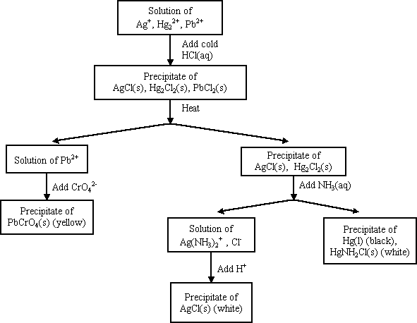
Precipitation and Qualitative Analysis

Slide 7
Complex Ions
A Complex ion is a charged species composed of:
1. A metallic cation
2. Ligands – Lewis bases that have a lone electron pair that can form a covalent bond with an empty orbital belonging to the metallic cation

Slide 8
NH₃, CN⁻, and H₂O are Common Ligands

Slide 9
Coordination Number
Coordination number refers to the number of ligands attached to the cation
2, 4, and 6 are the most common coordination numbers
Coordination number | Example(s)
2 | Ag(NH₃)₂⁺
4 | CoCl₄²⁻ Cu(NH₃)₄²⁺
6 | Co(H₂O)₆²⁺ Ni(NH₃)₆²⁺

Slide 10
Complex Ions and Solubility
AgCl(s)  Ag⁺ + Cl⁻ K_{sp} = 1.6 x 10⁻¹⁰
Ag⁺ + NH₃  Ag(NH₃)⁺ K₁ = 2.1 x 10³
Ag(NH₃)⁺ NH₃  Ag(NH₃)₂⁺ K₂ = 8.2 x 10³
AgCl + 2NH₃  Ag(NH₃)₂⁺ + Cl⁻
K = K_{sp}⋅K₁⋅K₂

