Slide 1
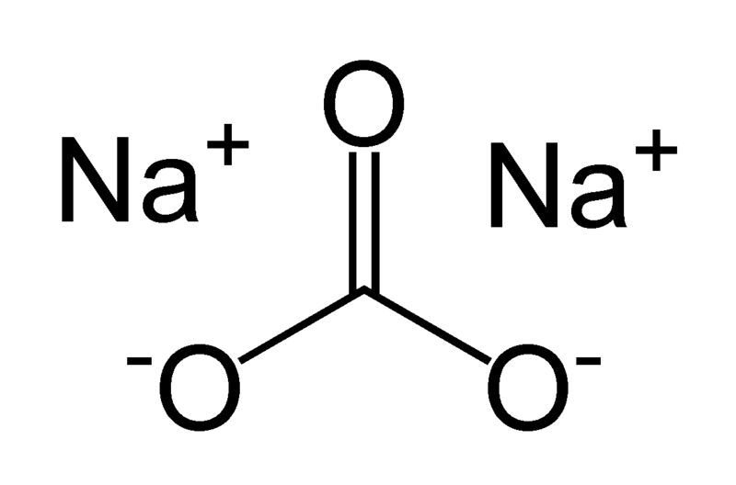
Acid-Base Properties of Salts

Slide 2
Acid-Base Properties of Salts
Type of Salt | Examples | Comment | pH of solution
Cation is from a strong base, anion from a strong acid | KCl, KNO₃ NaCl NaNO₃ | Both ions are neutral | Neutral
These salts simply dissociate in water:
KCl(s) → K⁺(aq) + Cl⁻(aq)

Slide 3
Acid-Base Properties of Salts
Type of Salt | Examples | Comment | pH of solution
Cation is from a strong base, anion from a weak acid | NaC₂H₃O₂ KCN, NaF | Cation is neutral, Anion is basic | Basic
The basic anion can accept a proton from water:
C₂H₃O₂⁻ + H₂O  HC₂H₃O₂ + OH- base acid acid base

Slide 4
Acid-Base Properties of Salts
Type of Salt | Examples | Comment | pH of solution
Cation is the conjugate acid of a weak base, anion is from a strong acid | NH₄Cl, NH₄NO₃ | Cation is acidic, Anion is neutral | Acidic
The acidic cation can act as a proton donor:
NH₄⁺(aq)  NH₃(aq) + H⁺(aq)
Acid Conjugate Proton
base

Slide 5
Acid-Base Properties of Salts
Type of Salt | Examples | Comment | pH of solution
Cation is the conjugate acid of a weak base, anion is conjugate base of a weak acid | NH₄C₂H₃O₂ NH₄CN | Cation is acidic, Anion is basic | See below
IF K_{a} for the acidic ion is greater than K_{b} for the basic ion, the solution is acidic
IF K_{b} for the basic ion is greater than K_{a} for the acidic ion, the solution is basic
IF K_{b} for the basic ion is equal to K_{a} for the acidic ion, the solution is neutral

Slide 6
Acid-Base Properties of Salts
Type of Salt | Examples | Comment | pH of solution
Cation is a highly charged metal ion; Anion is from strong acid | Al(NO₃)₂ FeCl₃ | Hydrated cation acts as an acid; Anion is neutral | Acidic
Step #1:
AlCl₃(s) + 6H₂O → Al(H₂O)₆³⁺(aq) + Cl⁻(aq)
Salt water Complex ion anion
Step #2:
Al(H₂O)₆³⁺(aq) → Al(OH)(H₂O)₅²⁺(aq) + H⁺(aq)
Acid Conjugate base Proton

Slide 7
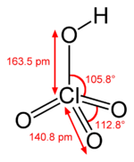
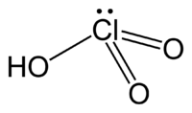
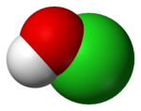
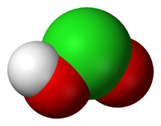
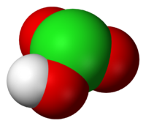
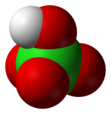
Effect of Structure on Acid-Base Properties
Hypochlorous
acid
Chlorous
acid
Chloric
acid
Perchloric
acid
Increasing Acidity

